Slide 1
Motion Planning Under Spatio-Temporal Constraints
Jeel Chatrola Dev Soni

Slide 2
Motivation
Traditional Approach :- Most motion planning algorithms compute a path that connects a start configuration S and a goal configuration G, while avoiding collision with known obstacles.
Challenges :-
Real World applications require solving more complex tasks. E.g. go to location A first then go to location B, after that go back to start location.
Multi-query Problem ( Multiple goals and constraints ).
Heterogeneous robots ( ground, aerial, etc )

Slide 3
Current Progress
We Started with Implementing a Multi-goal RRT which can be expressed as STL specification without time specifications.
Kinodynamic RRT for single goal task
We modify RRT Algorithm which can solve for a small class of STL specifications
Reach avoid specification
Non-overlapping conditions and Positive Normal
Upper Bounded intervals i.e. [0, t]

Slide 4
Results so far
We modify RRT to achieve multi-goal task specifications.

Slide 5

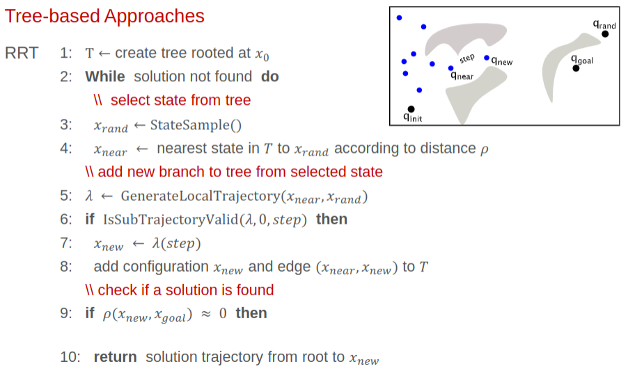
Continue …
Kinodynamic RRT for a dynamical system -
X = [x,y] and u = [u1, u2]

Slide 6
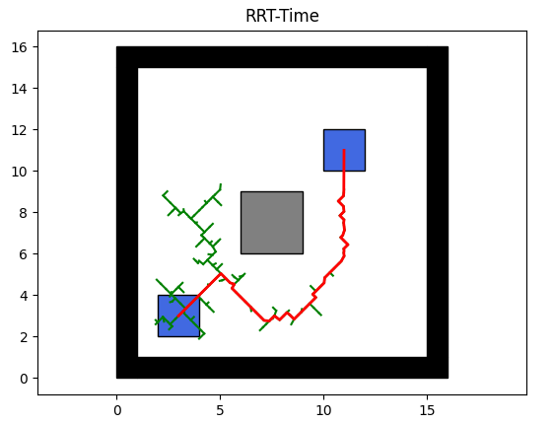
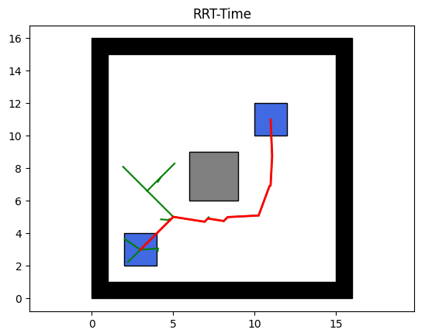
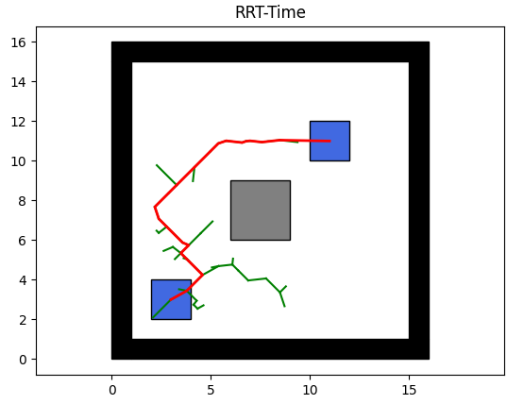
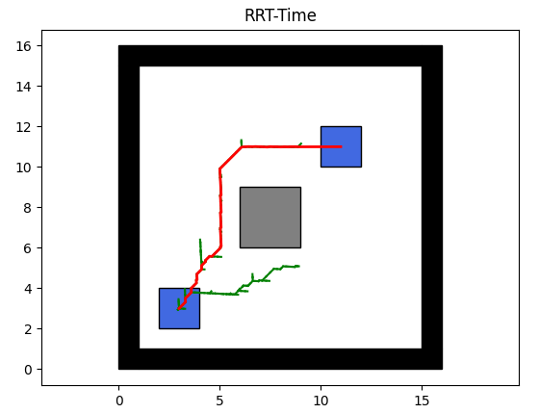
Results
U = [-0.5,0.5] - n = 10
T = [0,0.5], dt = 0.1
Time to goal = 18.61
No of Nodes = 68
U = [-2,2] - n = 20
T = [0,1], dt = 0.01
Time to goal = 5.388
No of Nodes = 14
U = [-1,1] - n = 10
T = [0,1], dt = 0.1
Time to goal = 10.43
No of Nodes = 23
U = [-0.1,2] - n = 10
T = [0,0.1], dt = 0.01
Time to goal = 4.99
No of Nodes = 94

Slide 7
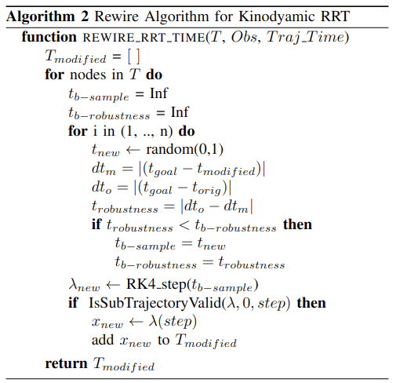
Modification
Instead of modifying the Kinodynamic RRT we will extract the final path and rewire a new path around that using the specification

Slide 8
Future Work
Next we will investigate how to combine STL with KPIECE or Sysclop.
Use Partial robustness calculation to plan on the fly to satisfy the given STL specification.
Extend Class of Specifications to general STL rather than a subset.

Slide 9
References
There are several works addressing this problem using Different temporal logic formulations ( LTL, MITL, STL, scLTL, etc. )
J Karlsson et al,. Sampling-based Motion Planning with Temporal Logic Missions and Spatial Preference.
Vasile et al,. Sampling-bases synthesis of maximally-satisfying controllers for temporal logic specifications.

Slide 10
Thanks!
Any questions?

